Slide 1

Software Construction & Development
Topic: Abstract Factory Pattern
Instructor: Ma’am Alina Munir

Slide 2
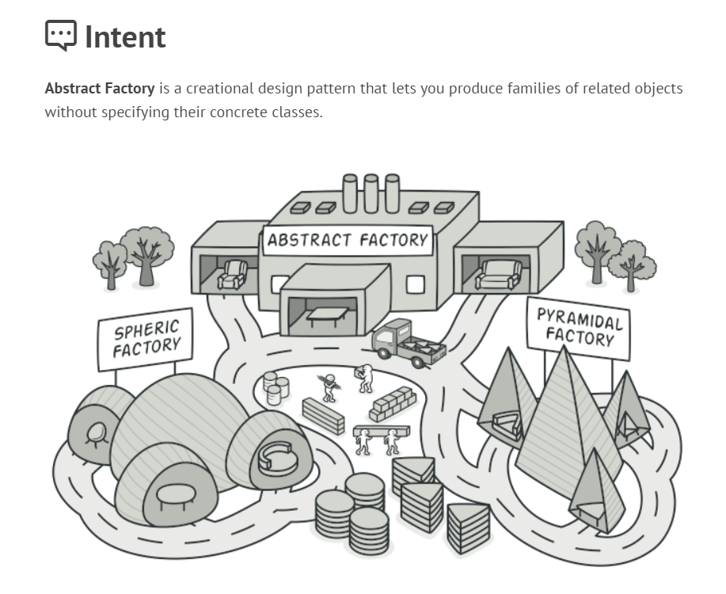

Slide 3
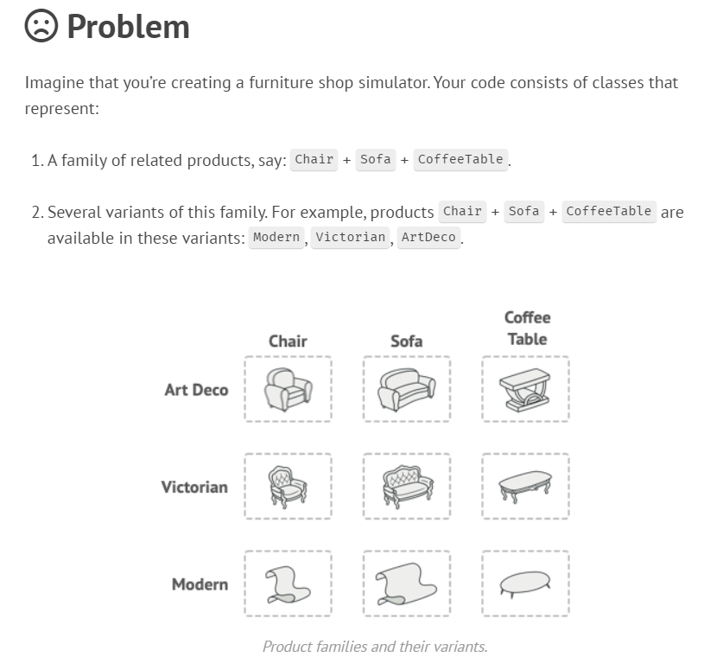

Slide 4
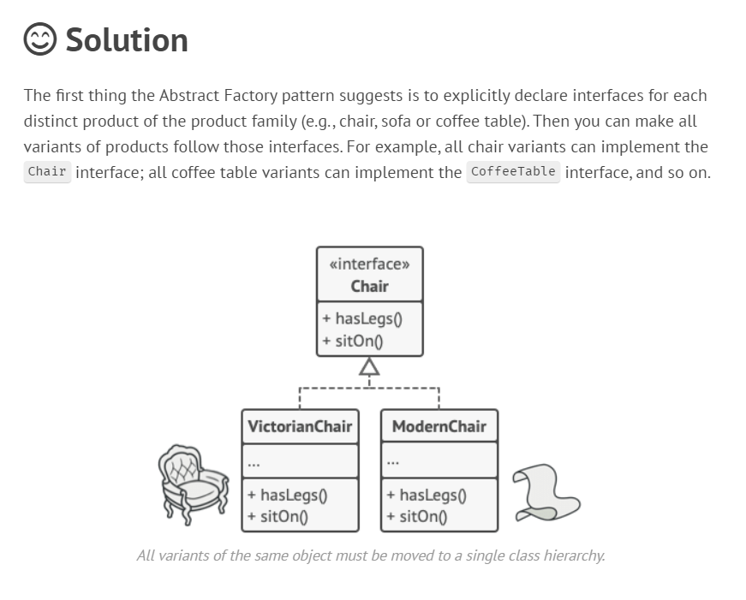

Slide 5
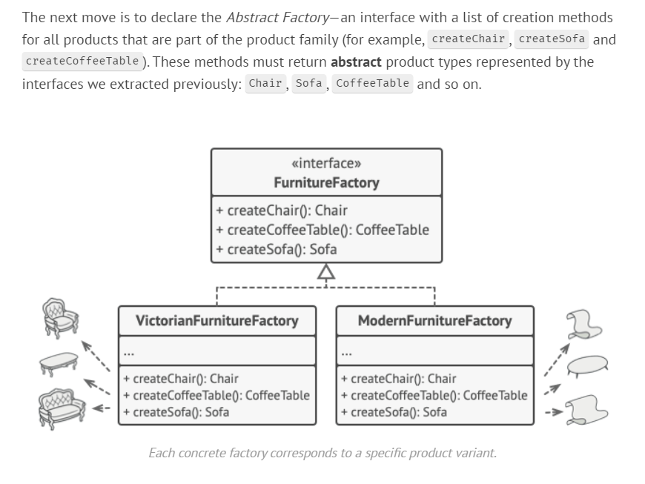

Slide 6
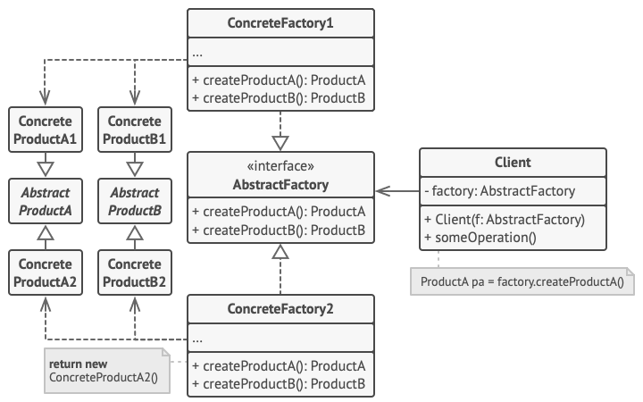
UML:

Slide 7

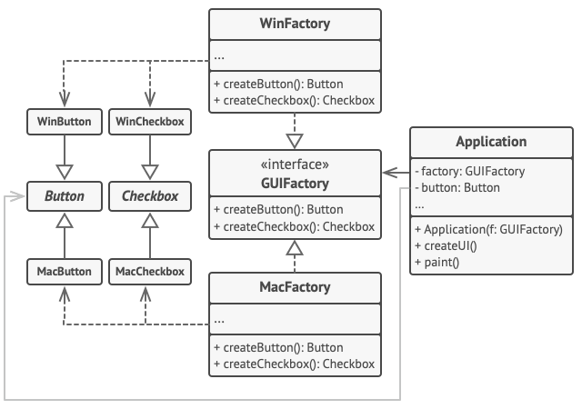

Slide 8
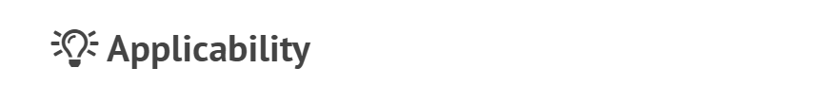
Handles various families of related products without depending on concrete classes.
Ensures compatibility among created objects within the same family.
Facilitates future extensibility by allowing seamless addition of new product types.
Useful when a class's responsibilities become unclear due to multiple product types.
Provides a clean and modular design by separating the creation of objects into dedicated factories.

Slide 9
